Slide 1

BY: DWIJ VERMA AVM JUHU
MUMBAI, MAHARASHTRA

Slide 2


Slide 3


Slide 4
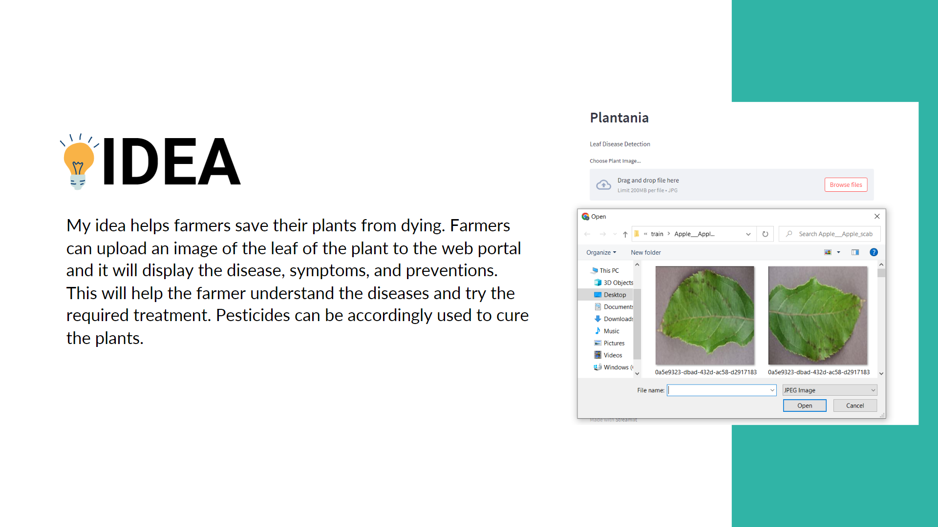

Slide 5
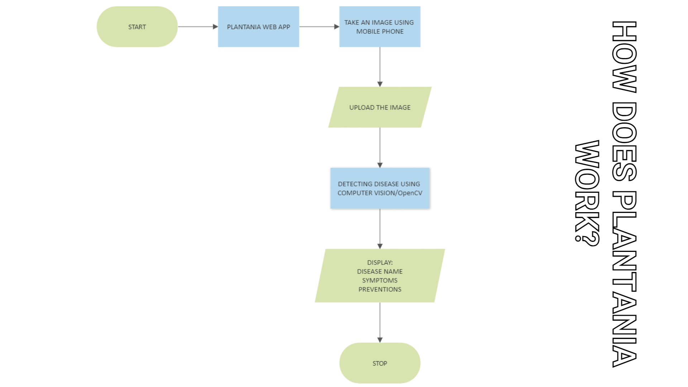

Slide 6
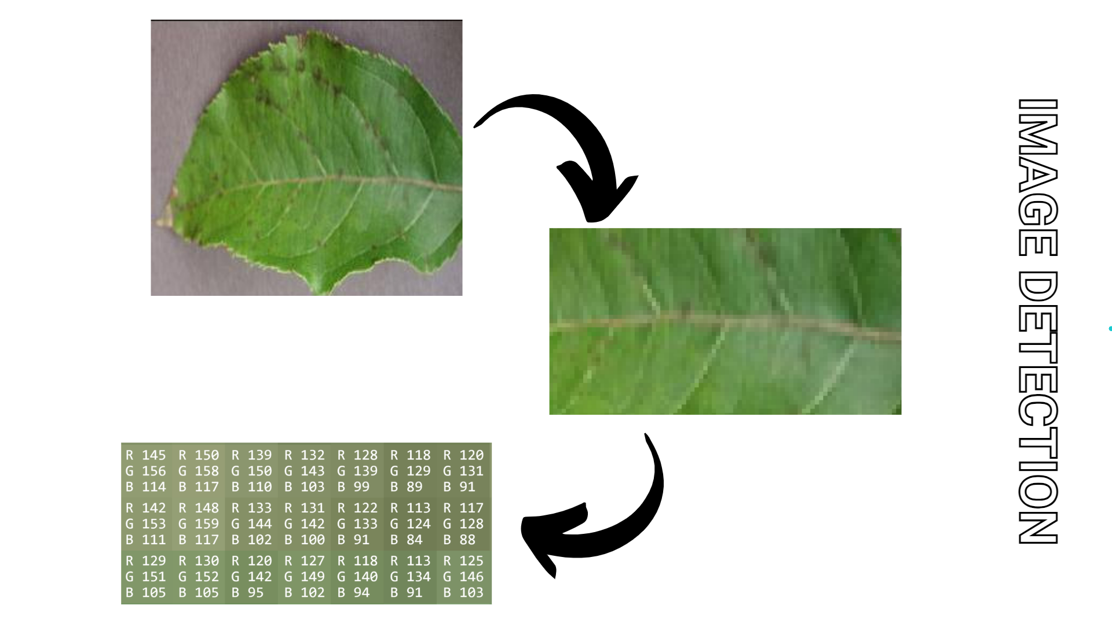

Slide 7
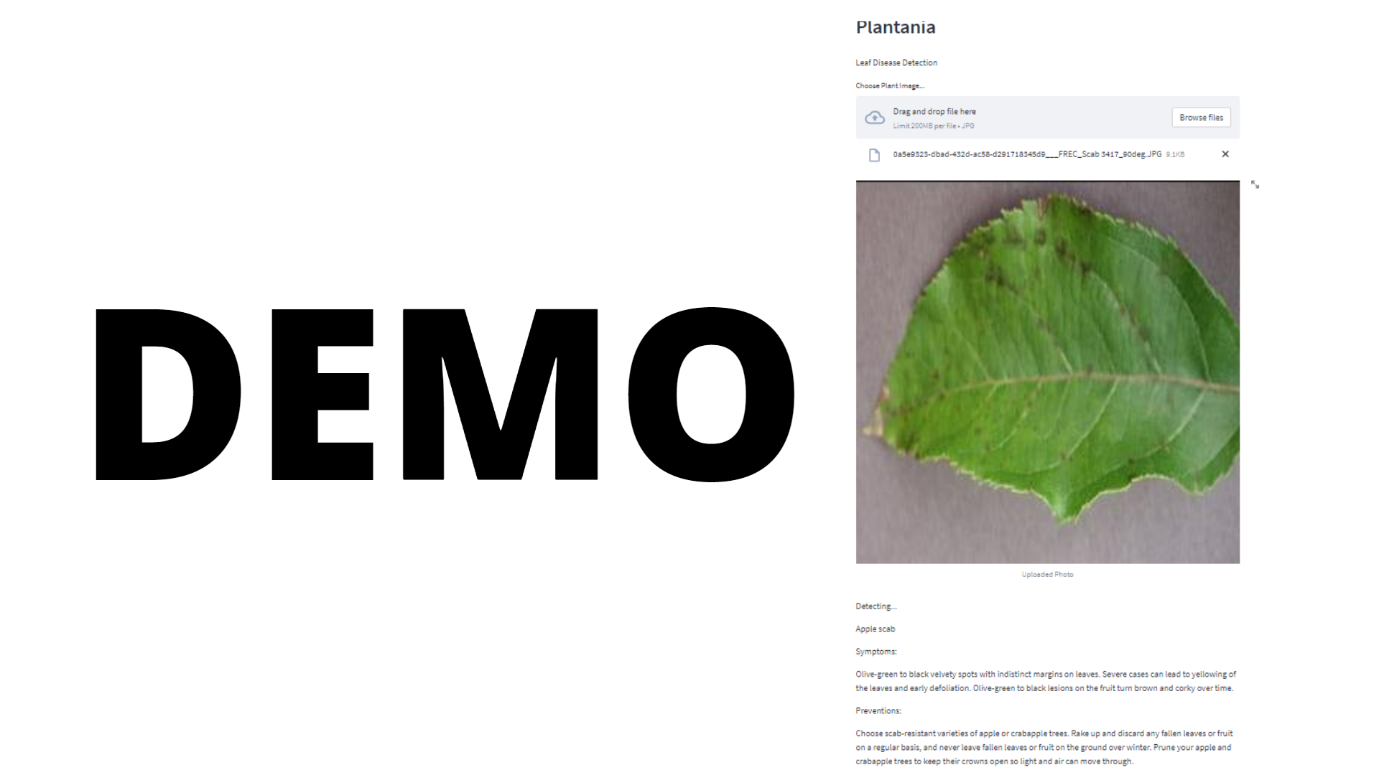

Slide 8


Slide 9
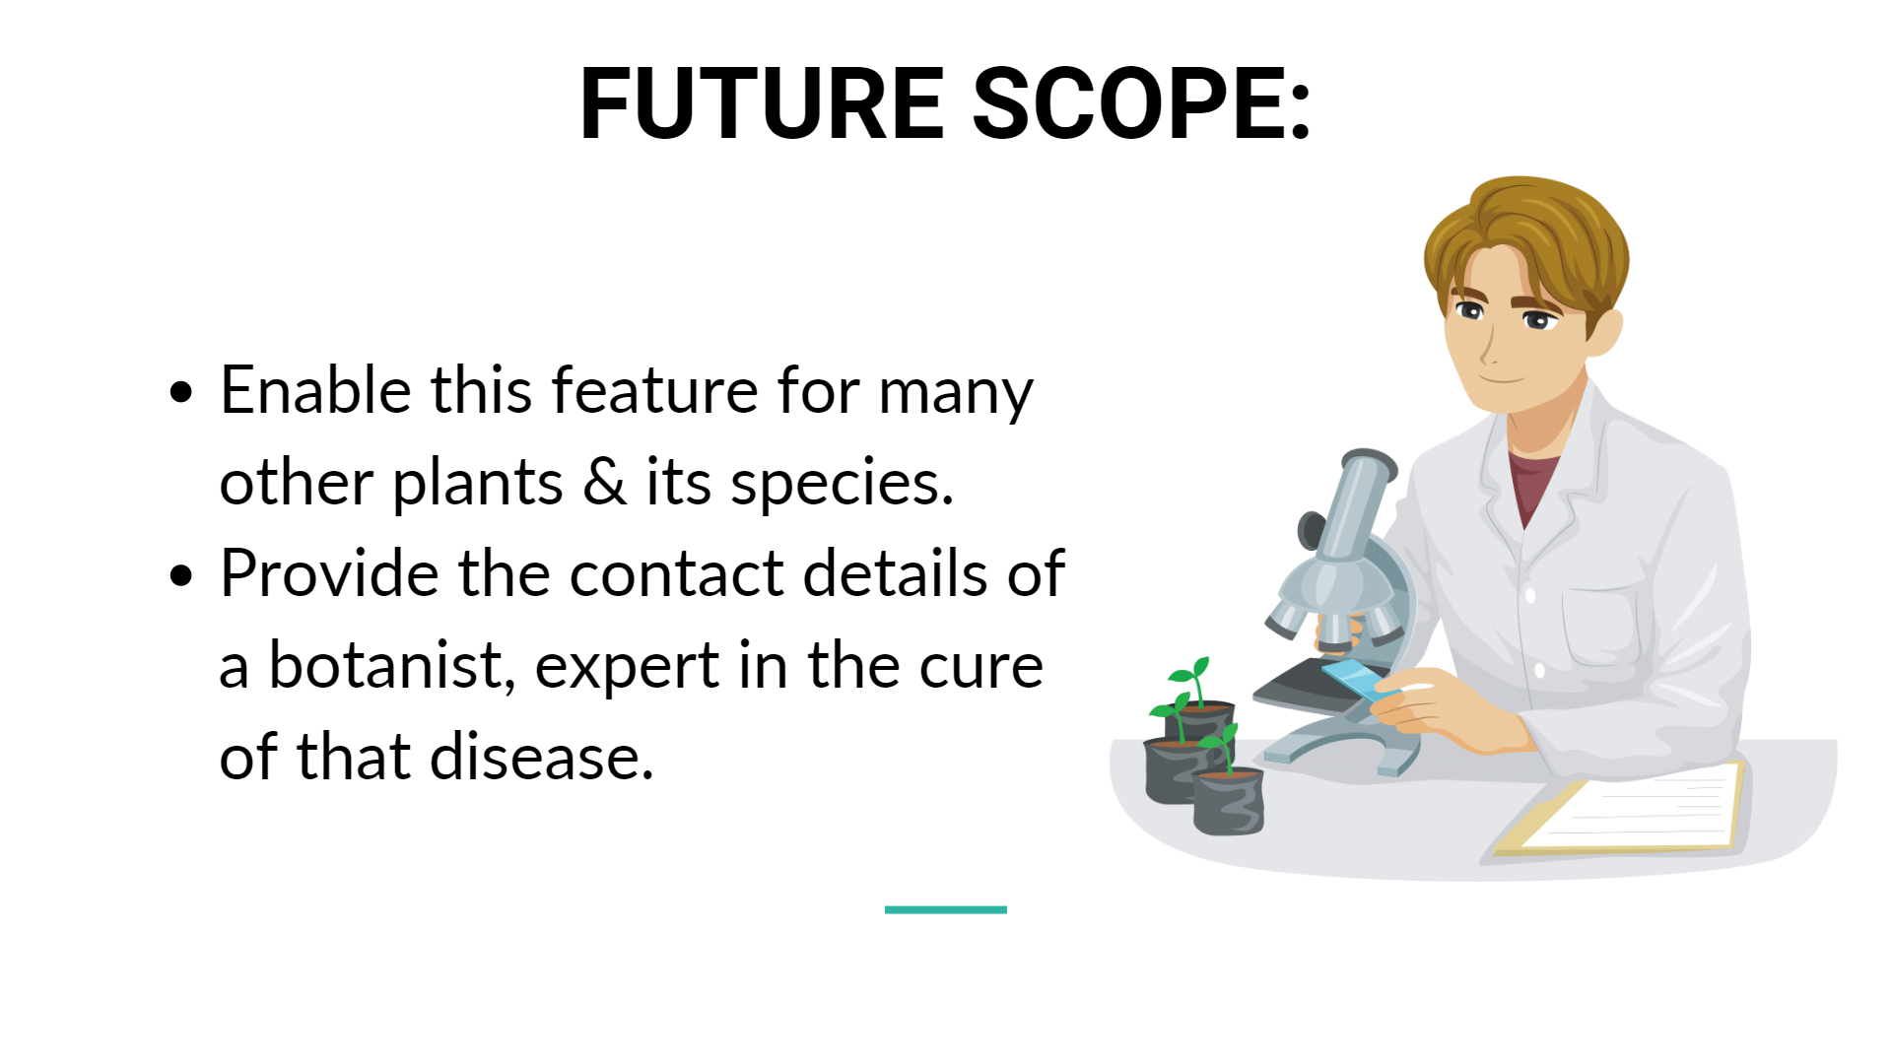

Slide 10


